Slide 1
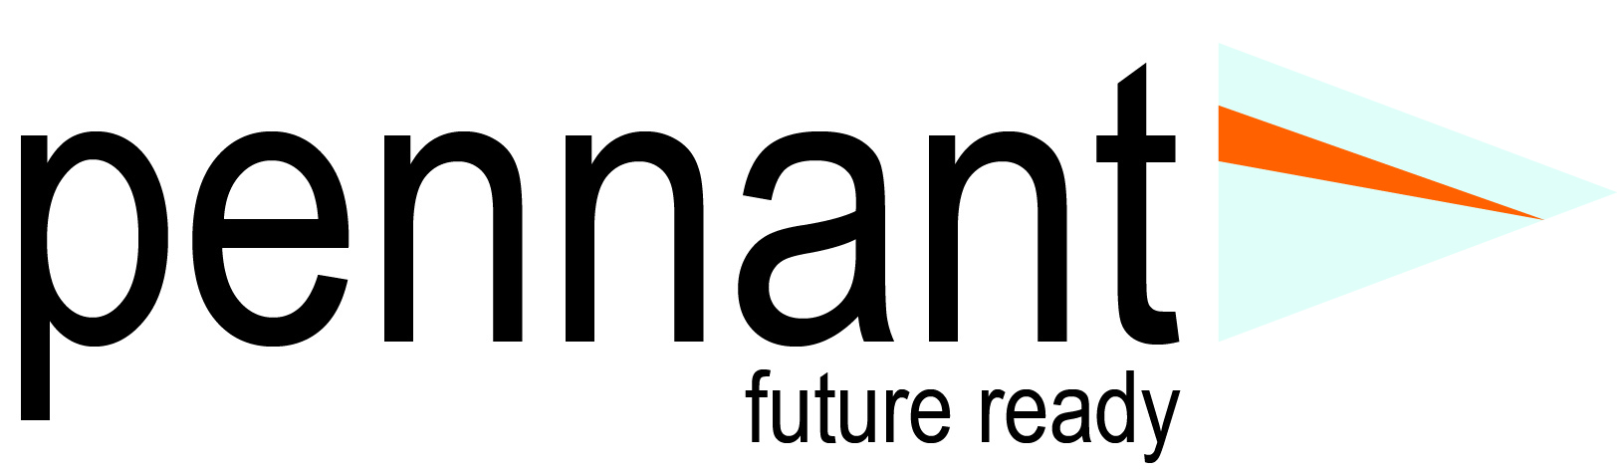
Pennant Technologies Private Limited
Spring MVC in Java

Slide 4
Spring MVC
A Spring MVC is a Java framework which is used to build web applications.
It follows the Model-View-Controller design pattern.
It implements all the basic features of a core spring framework like Inversion of Control, Dependency Injection.
A Spring MVC provides an elegant solution to use MVC in spring framework by the help of DispatcherServlet.
Here, DispatcherServlet is a class that receives the incoming request and maps it to the right resource such as controllers, models, and views.

Slide 5
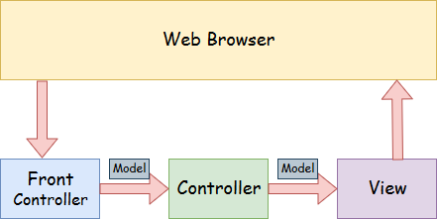
Spring MVC

Slide 6
Spring Web Model-View-Controller
Model - A model contains the data of the application. A data can be a single object or a collection of objects.
Controller - A controller contains the business logic of an application. Here, the @Controller annotation is used to mark the class as the controller.
View - A view represents the provided information in a particular format. Generally, JSP+JSTL is used to create a view page. Although spring also supports other view technologies such as Apache Velocity, Thymeleaf and FreeMarker.
Front Controller - In Spring Web MVC, the DispatcherServlet class works as the front controller. It is responsible to manage the flow of the Spring MVC application.

Slide 7
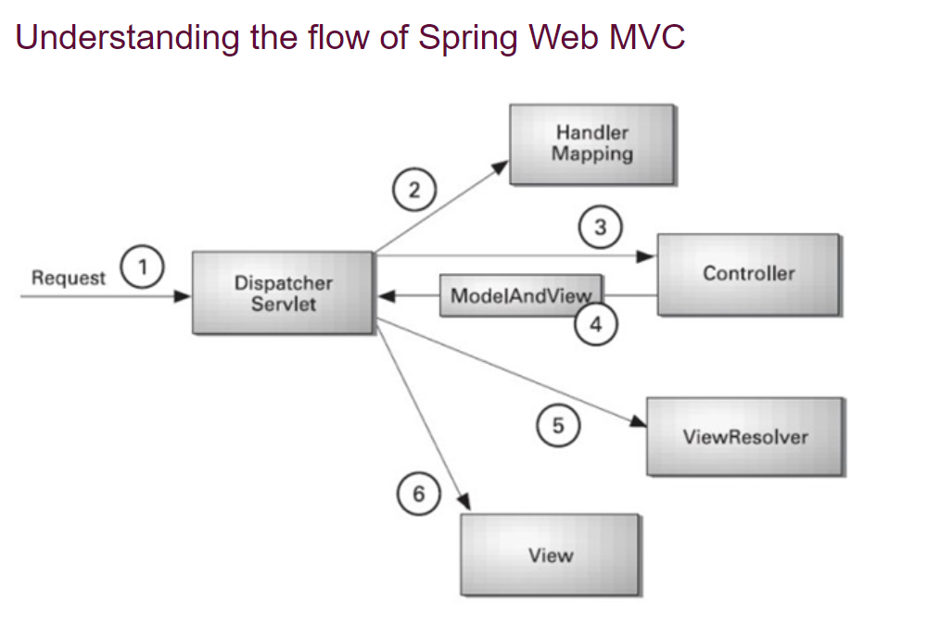

Slide 8
Advantages of Spring MVC Framework
Separate roles - The Spring MVC separates each role, where the model object, controller, command object, view resolver, DispatcherServlet, validator, etc. can be fulfilled by a specialized object.
Light-weight - It uses light-weight servlet container to develop and deploy your application.
Powerful Configuration - It provides a robust configuration for both framework and application classes that includes easy referencing across contexts, such as from web controllers to business objects and validators.
Rapid development - The Spring MVC facilitates fast and parallel development.
Reusable business code - Instead of creating new objects, it allows us to use the existing business objects.
Easy to test - In Spring, generally we create JavaBeans classes that enable you to inject test data using the setter methods.
Flexible Mapping - It provides the specific annotations that easily redirect the page.

Slide 9
Disadvantages of Spring MVC Framework
It has high complexity to develop the applications using this pattern.
It is not suitable for small applications which affect the application’s performance and design.

Slide 10
Spring Web MVC Framework Example
Load the spring jar files or add dependencies in the case of Maven
Create the controller class
Provide the entry of controller in the web.xml file
Define the bean in the separate XML file
Display the message in the JSP page
Start the server and deploy the project

Slide 11
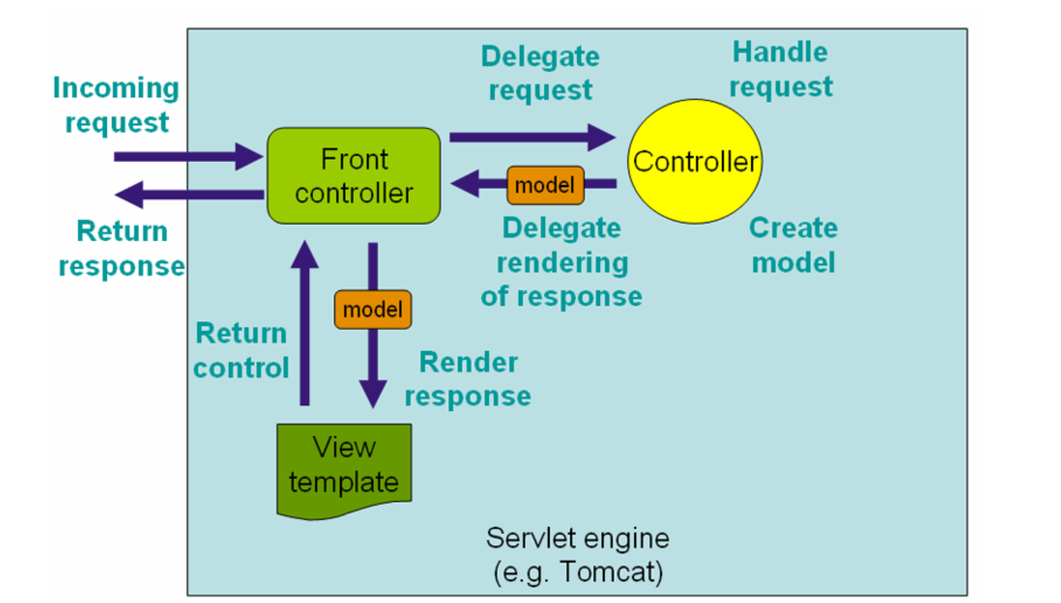
Dispatcher Servlets

Slide 12
The DispatcherServlet
Spring's web MVC framework is, like many other web MVC frameworks, request-driven, designed around a central Servlet that dispatches requests to controllers and offers other functionality that facilitates the development of web applications.
Spring's DispatcherServlet however, does more than just that. It is completely integrated with the Spring IoC container and as such allows you to use every other feature that Spring has.
The request processing workflow of the Spring Web MVC DispatcherServlet is illustrated in the following diagram.
The pattern-savvy reader will recognize that the DispatcherServlet is an expression of the “Front Controller” design pattern (this is a pattern that Spring Web MVC shares with many other leading web frameworks).

Slide 13
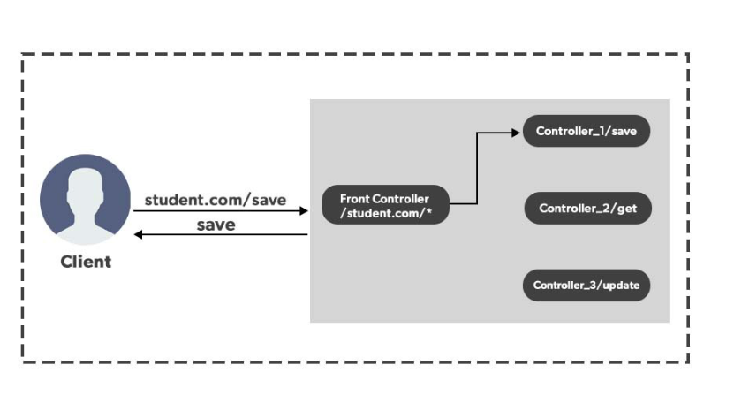
Realtime Example

Slide 14
DispatcherServlet handles an incoming HttpRequest, delegates the request, and processes that request according to the configured HandlerAdapter interfaces that have been implemented within the Spring application along with accompanying annotations specifying handlers, controller endpoints, and response objects.

Slide 15
